Slide 1
Labor Support Skills Workshop
Promoting Primary Vaginal Deliveries
Slides Available at:
https://tinyurl.com/LaborSupportSlides

Slide 2
Begin with a Test:
You are about to give birth. Pregnancy has gone smoothly. The birth seems as if it will, too. It’s one baby, in the right position, full term, and you’ve never had a cesarean section — in other words, you’re at low risk for complications.
What’s likely to be the biggest influence on whether you will have a C-section?
(A) Your personal wishes.
(B) Your choice of hospital.
(C) Your baby’s weight.
(D) Your baby’s heart rate in labor.
(E) The progress of your labor.
Rosenberg T, NYT, Jan 19 2016
2

Slide 3
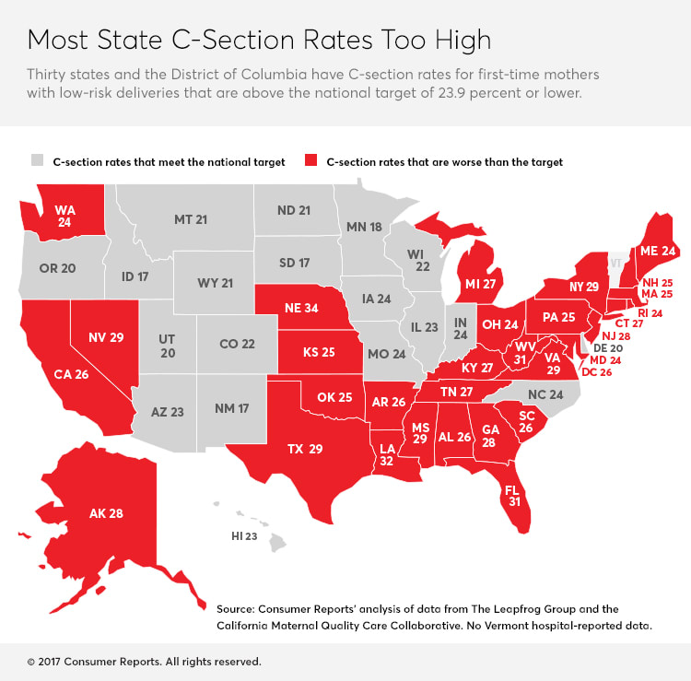

Slide 4
NTSV Cesarean Rates, U.S. States, 2020
FL 27.8
US
25.6
HP 2030 Goal—23.6%
Source: NCHS (2021) Provisional Birth Data 2020

Slide 5
2020 Low-Risk Nulliparous Term Singleton Vertex - NTSV Cesarean Rate, Florida birthing hospitals
Range: 15.1%-53.4%
Mean: 29%
Median: 27.7%

Slide 6
Lamaze International infographic available free online

Slide 7
Cesarean: Maternal Risks
Acute
Long Term & Subsequent Births
Common:
Longer hospital stay
Increased pain and fatigue
Postpartum hemorrhage (transfusions ~2%)
Slower return to normal activity and productivity
Delayed or difficult breastfeeding
1/100 to 1/1000
Anesthesia complications
Wound infection
Deep vein thrombosis
1/100 to 1/1000
Abnormal placentation (previas and accretas)
Uterine rupture
Surgical adhesions
Bladder surgical injury
Bowel surgical injury
Bowel obstruction
We perform over 160,000 Cesareans every year in California
7
Notes:
Many of the serious complications are uncommon , <1% but we do over 160,000 cesarean sections EVERY year in California so they do add up quickly.
This is particularly true now that we are seeing women with multiple prior CS where the risks do increase significantly.

Slide 8
Maternal Psychological Risks
ACUTE
Delayed and/or ineffective bonding with neonate
Maternal anxiety
LONGER TERM
Post traumatic stress disorder (PTSD)
Postpartum anxiety and depression
8
Notes:
Psychological stress, anxiety, and post-traumatic stress disorder (PTSD) have been identified as potential risks of cesarean. A good point to mention shared decision making during prenatal, intrapartum care. We can decrease the loss of control and anxiety women may associate with the cesarean through effective communication.

Slide 9
Cesarean: Neonatal Risks
Increased neonatal morbidity
Impaired neonatal respiratory function
Increased NICU admissions
Affects maternal-newborn interactions including breastfeeding
Unrealized benefits
Cerebral Palsy rates, neonatal seizure rates unchanged since 1980
9
Notes:
With the exception of fetuses in breech presentation, neonates have reaped few benefits with the rising rate of cesarean birth. Cerebral palsy rates have remained unchanged in the past 15 years, and recent evidence indicates that significant health consequences, including higher rates of serious respiratory complications, higher admission to the NICU, and development of childhood asthma requiring hospitalization and inhaler use are more likely in babies born by cesarean. Furthermore, cesarean birth remains a barrier to early breastfeeding support, delays the first feeding, and delays or completely interferes with early
skin-to-skin contact, all of which adversely affect the ability to exclusively breastfeed

Slide 10
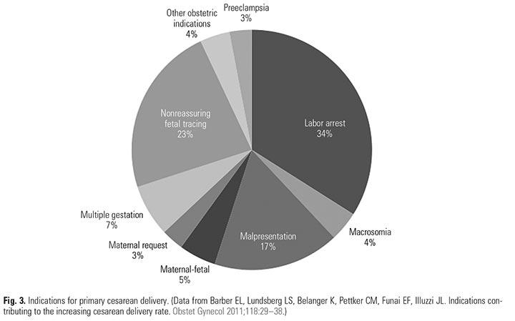
Indications for Primary Cesarean
Safe prevention of the primary cesarean delivery. Obstetric Care Consensus No. 1. American College of Obstetricians and Gynecologists. Obstet Gynecol 2014;123:693–711.

Slide 11
What Indications Have Driven the RISE in CS?
(
 | Percent of the Increase in Primary Cesarean Rate Attributable to this Indication
Cesarean Indication | Yale (2003 v. 2009) (Total: 26% to 36.5%) Focus: all primary Cesareans | Kaiser SoCal (1991 v. 2008) (Primary: 12.5% to 20%) Focus: all primary singleton Cesareans
Labor progress complications (CPD/FTP) | 28% | ~38%
Fetal Intolerance of Labor | 32% | ~24%
Breech/Malpresentation | <1% | <1%
Multiple Gestation | 16% | Not available
Various Obstetric and Medical Conditions (Placenta Abnormalities, Hypertension, Herpes, etc.) | 6% | 20% (Did not separate preeclampsia from other complications)
Preeclampsia | 10%
“Elective” (variously defined) | 8% (Scheduled without “medical indication”) | 18% (Those “without a charted indication”)
60%!
11
Notes:
From the California Collaborative we have the following information: Increased diagnosis of Labor complications is the main reason for the rise in CS rates in the last 15 years. It is not more breeches or more previas. Even elective deliveries make a small contribution.
A main focus of educational efforts within your hospital should involve a variety of topics around labor management. These should include areas for both nursing and physician/providers. FPQC is sponsoring regoinal labor support workshops to refresh physiologic labor support skills. More information will be provided to participants in the PROVIDE initiative.

Slide 12
What Indications Drive the VARIATION in CS?
CS Indication | Proportion of Overall CS Rate | Proportion of Primary CS Rate | CS Rate for this Indication
Repeat (prior) | 30-35% | --- | 90+%
“Abnormal Labor” (CPD/FTP) | 25-30% | 35-45% | Highly variable
Fetal Intolerance of labor | 10-15% | 15-20% | Highly variable
Breech/Transverse | 10% | 15-20% | 98%
Multiple Gestation | 5-9% | 10-15% | 60-80%
Other: Placenta Previa, Herpes, etc | ~5% | ~10% | 90%
60%!
12
Notes:
More information from CMQCC indicates that the diagnoses of labor complications account for the great majority of differences in CS rates between hospitals

Slide 13
Research Says Yes
Retrospective analysis of 3,031 NTSV births and 72 RNs
Tertiary care hospital
Threefold variation in cesarean rates across L&D RN-Ranged from 8.3% to 48%
No differences in GA, birth weight, or Apgars of the births amongst the four quartiles of RNs.
Research ongoing: Edmonds et al, JOGNN(50)632;2021
Edmonds et al. JOGNN 2017

Slide 14
The nurse assigned to a patient may influence the likelihood of cesarean birth
Nurses affect the clinical behaviors and labor management decisions of physicians
Nurses’ beliefs about birth
How much time nurse spends providing labor support vs other clinical duties
Skill and education level
“Nurses spend more time at the bedside than any other clinician.”

Slide 15
Alliance for Innovation in Maternity care (AIM) Safety Bundle for Safe Reduction of Cesarean
Readiness
Recognition and Prevention
Response to Every Labor Challenge
Reporting
Notes:
The CMQCC Toolkit translates the AIM Safety Bundle into an easy-to-use “menu” of tools and practical approaches. Each section of the toolkit mirrors the 4 “Rs” of the AIM Bundle: Readiness, Recognition and Prevention, Response, and Reporting.

Slide 18
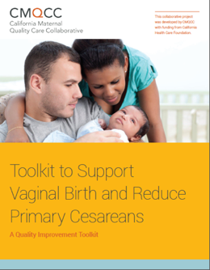
The CMQCC Toolkit
Comprehensive, evidence-based “How-to Guide” to reduce primary cesarean delivery in the NTSV population
Will be the resource foundation for the FPQC collaborative project
The principles are generalizable to all women giving birth
Released on the CMQCC website April 28, 2016
Has a companion Implementation Guide
18
Notes:
The initiative focuses on reducing the first birth cesarean using the CMQCC toolkit. The materials are evidence based and will be supplemented with materials developed specifically for Florida by our diverse advisory team.

Slide 19
FPQC PROVIDE Project Planning and Support
Florida Department of Health
American College of Obstetricians & Gynecologists (ACOG) District XII
Florida Chapter of the Association of Women’s Health, Obstetric, and Neonatal Nurses (AWHONN)
Florida affiliate of the American College of Nurse Midwives (ACNM)
Alliance for Innovation in Maternal Health (AIM)
California Maternal Quality Care Collaborative (CMQCC)
Representatives from provider groups, hospitalists, health plans, nurses, hospital administration, public health, childbirth educators, and doulas.
Notes:
FPQC receives broad support for QI Collaborative Projects, this project is supported by:
Florida Department of Health
American College of Obstetricians and Gynecologists (ACOG) District XII
Florida Chapter of the Association of Women’s Health, Obstetric, and Neonatal Nurses (AWHONN)
Florida affiliate of the American College of Nurse Midwives (ACNM)
Alliance for Innovation in Maternal Health (AIM)
California Maternal Quality Care Collaborative (CMQCC)
Representatives from provider practice groups, hospitalists, health plans, hospital nurses and administration, public health professionals, childbirth educators, and doulas.

Slide 20
PROVIDE Goals
The Advisory Group proposes the PROVIDE initiative hospitals reduce their NTSV cesarean rates at least 20% over the 18-month initiative.
The ultimate goal is for Florida’s rate to match if not surpass the U.S. rate in three years.

Slide 21
FPQC Recommended Key Practices
Improve access to and promote quality childbirth education, informed consent, and shared decision making
Implement institutional policies that uphold best practices in obstetrics, safely reduce routine interventions in low-risk women, and consistently support vaginal birth
Educate nurses and providers on intermittent auscultation/EFM and implement intermittent monitoring for low-risk women
Educate nurses on labor support skills that promote labor progress, labor support, pain management
Educate and encourage providers: external version, operative vaginal delivery, breech delivery
Note to presenter: Will be reviewed in depth during implementation talk
Notes:
Note to presenter: Will be reviewed in depth during implementation talk

Slide 22
FPQC Recommended Key Practice
Establish standard criteria for induction, active labor admission and assess all women on admission
Encourage use of doulas and create doula-friendly policies
Increase access to non-pharmacological pain management/labor progression tools
Implement standard diagnostic criteria and responses to labor challenges and HR abnormalities
Track provider-level cesarean section rates and conduct case reviews to drive improvement
Note to presenter: Will be reviewed in depth during implementation talk
Notes:
Note to presenter: Will be reviewed in depth during implementation talk

Slide 23
Collaborative Resources
PROVIDE Online Tool Box
Algorithms, Sample order sets, Education tools, Slide sets, etc.
Customized On-site Consultations & Grand Rounds
Monthly QI Data Reports
Monthly PROVIDE Learning and Collaboration Webinars
PROVIDE in-person collaboration meetings
Monthly e-mail Bulletins
Technical Assistance from FPQC Staff and Clinical Advisors

Slide 24
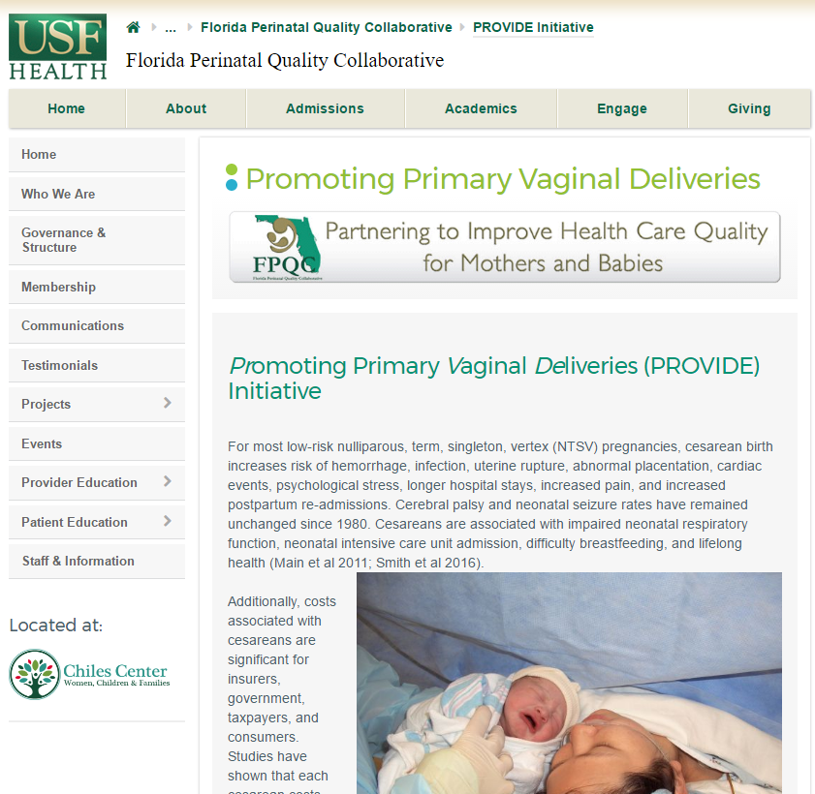
How to Access Tools, Resources, Guides, etc.
http://health.usf.edu/publichealth/chiles/fpqc/provide/toolbox

Slide 25
Questions?

Slide 26
Are You Connected?
Facebook.com/TheFPQC/
@TheFPQC
Join our mailing list at FPQC.org
E-mail: FPQC@usf.edu
Notes:
At FPQC.org you can find information about current and past projects and join our mailing list. We have a facebook page and twitter account as well. You can also email us at FPQC@health.usf.edu
http://health.usf.edu/publichealth/chiles/fpqc/provide is the specific site for PROVIDE

